Slide 1
Khadi and Village Industries Commission Project Proposal
Presentation
on
Proposed Project Entitled
“Introduction to Redesigned Bamboo Slicing Machine and Homestead Round Stick-making Machine for Sustainable Agarbatti Production in Micro and Small Enterprises”
Project Coordinators
Dr. Pritam Das, Associate Professor (Presenting Author)
Dr. Arindam Majumder, Assistant Professor
Dr. Dipak Chandra Das, Assistant Professor
Department of Mechanical Engineering,
National Institute of Technology Agartala,
Jirania, West Tripura, Tripura, Pin – 799046, India
in collaboration with
Raado Bamboo Welfare Corporation
14.03.2024

Slide 2
Khadi and Village Industries Commission Project Proposal
Origin of the Proposal
Tripura has 2397 sq. Km of bamboo forests (23% geographical area) (Source: Tripura Forest Department)
In 2008, the bamboo sticks supplied by Tripura state to the Agarbatti manufacturing industries of India was reduced from 90% to 60% (Source: Kerala Forest Research Institute Journal)
Justification for the Project
- Manual processes drawbacks:
Low productivity
Poor product quality
Increased wastage
- Existing machine challenges:
Three-phase power requirement
Heavyweight and large size
High operational costs
(A) (B)
Fig. 1. (A) Bamboo slicing and (B) Stick-making process performed by the workers in small-scale industries of Tripura
(A) (B)
Fig. 2. Semi-Automatic (A) Bamboo Slicing Machine and (B) Homestead Round Stick-Making Machine used in small-scale industries of Tripura
14.03.2024

Slide 3
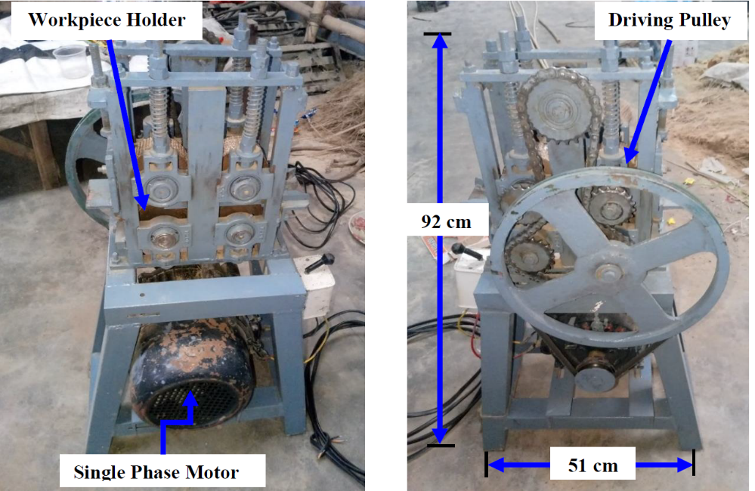
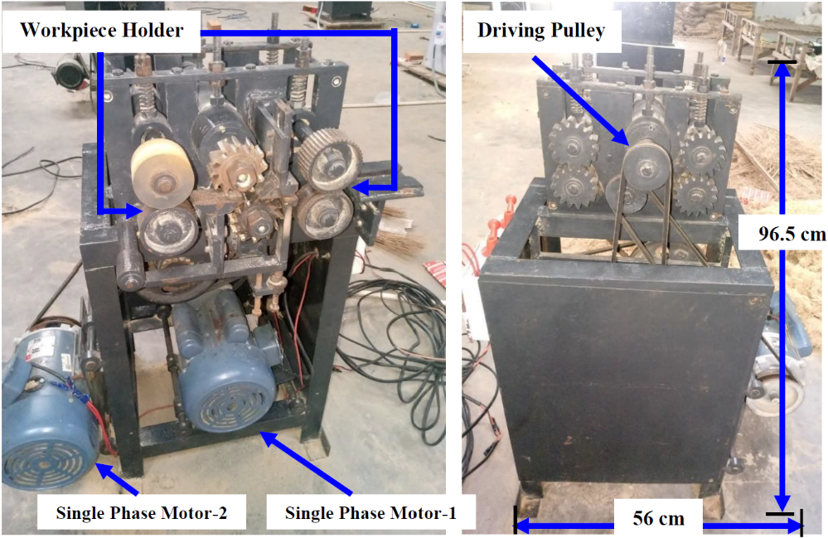
Khadi and Village Industries Commission Project Proposal
Contd.
Objectives of the Proposed Study
- Introduce low-cost machines:
Bamboo slicing machine
Homestead round stick-making machine
Key Objectives:
Cost reduction
Space optimization
Setup cost reduction
Operational cost reduction
Capacity building and training
Encouraging automation, entrepreneurship
Level of Work Done So Far
- Literature Review:
Emphasis on manual efficiency and cutter redesign
Lack of single-phase operated machines
- Collaboration with Raado Bamboo Welfare Corporation
Prototype development
Fig. 3. Bamboo Slicing Machine
Prototypes of Redesigned
Fig. 2. Homestead Round Stick-Making Machine
NIT Agartala
14.03.2024

Slide 4
Khadi and Village Industries Commission Project Proposal
Contd.
Relevance and Justifications to KVI Sector
- Economic benefits:
Cost reduction
Efficiency improvements
Productivity enhancements
Quality improvements
Raw material utilization
Implementation Methodology
1. Testing in real-life conditions
2. Modification based on test results
3. Organizing workshops and training programs
Potential Areas for Micro-enterprise Promotion
Bamboo stick making
Indirect promotion in agarbatti and handicrafts industries
Scientific and Technical Interventions
Single-phase motor usage
Reduction in motor requirement
Replacement of belt drives with chain drives
Training Programme
Workshops and training programs
Targeting women empowerment
Time Schedule (Month-wise Action Plan)
Activity | Months
 | 1-2 | 3-4 | 5-6 | 7-8 | 9-11 | 12
Testing and modification of prototypes
Manpower recruitment
Workshops and training programs
Project report preparation
NIT Agartala
14.03.2024

Slide 5
Khadi and Village Industries Commission Project Proposal
Contd.
Linkages Envisaged
NIT Agartala, Raado Bamboo Welfare Corporation, KVIC, Tripura Bamboo Mission Board
Follow-up Mechanism
Feedback collection in three phases
Worker feedback during testing
Artisan/technician feedback post-training
Feedback post-commercialization
Expected Outcome
- Cost-effective solutions
- Reduced space and setup costs
- Skilled workers
- Increased productivity and profitability
- Improved rural livelihood
Exit Strategy
- Handover to Raado Bamboo Welfare Corporation
- Commercialization and supply to artisans/micro-enterprises
- Sustainable financing support
Expertise Available
Dr. Pritam Das
Expertise in design innovation, turbulent flow analysis, and numerical simulations
Dr. Arindam Majumder
Expertise in process optimization, manufacturing scheduling, and metaheuristics
Dr. Dipak Chandra Das
Expertise in boiling heat transfer, experimental investigations, and drying processes
NIT Agartala
14.03.2024

Slide 6
Budget Details (INR)
Contd.
Sr. No. | Item of Expenditure | 1st Year | Total
1 | Manpower* | 3,00,000 | 3,00,000
2 | Travel | 28,000 | 28,000
3 | Training Programmes* | 4,24,400 | 4,24,400
4 | Contingencies* | 2,95,000 | 2,95,000
 | Total | 10,47,400 | 10,47,400
 | Overhead (10% of the total expenditure) | 1,04,740 | 1,04,740
 | Total | 11,52,140 | 11,52,140
Manpower Budget Detail
Description | Year-1 | Total
Project Associate | Rs. 25,000 ×12 months = Rs 3,00,000/- | 3,00,000
Contingencies Budget Detail
Description |  | Year-1 | Total
Equipment |  | 200000 | 2,95,000
Transportation and Installation |  | 25000
Consumables | Bamboo | 15000
 | Printing | 10000
 | Hard Disc | 15000
 | Miscellaneous | 30000
Training Programmes Budget Detail
Workshop/Training Program | Year-1 (Rs.) | Total (Rs.)
Eight (8) nos. of 1-Day Workshop at each District of Tripura | 4,24,400 | 4,24,400
Particulars | Amount Required
Food and refreshments | 1,35,200
Stationary/ Miscellaneous | 85,200
Local travel | 1,04,000
Contingency | 1,00,000
 | 4,24,400
*Total Artisans of the training programmes: (10 Male + 10 Female from each district of Tripura) = 20*8 = 160
NIT Agartala
14.03.2024

Slide 7
Thank You
14.03.2024

